Slide 1
Soul Blade
ACT，PC/Console

Slide 2
An ancient Chinese mythology ACT Game
Market:
Inheritance and innovation of Chinese traditional culture can meet the Chinese players' cultural pursuit.
ACT game genres cater to Chinese market demands.
Gameplay:
Strategic integration of close and long-range combat.
High-risk, high-reward battle mode.
Creative and smart AI system.
Art:
Integrating the beauty of minorities culture 'Miao' in China into the game.
Breaking aesthetic fatigue of Chinese theme.

Slide 3
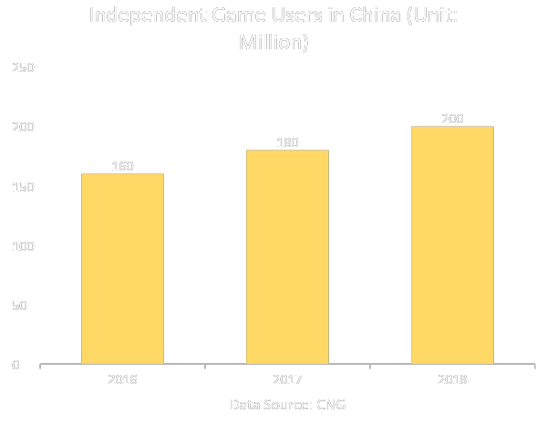
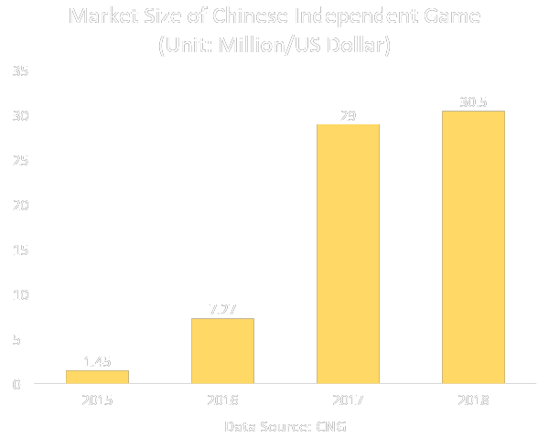
Data Analyse

Slide 4
Data Analyse - Genres of Market

Slide 5
Data Analyse - User Portrait
Target Audience: Chinese mainstream players
User Data: 88.8% Chinese players pay attention to traditional culture element in games, 86.6% would like to try culture background game, 43.4% players willing to play an ACT game reflecting Chinese traditional culture.
Vision: The combination of Western mainstream game types and ancient Eastern mythology.
Data Source: China Youth Daily

Slide 6

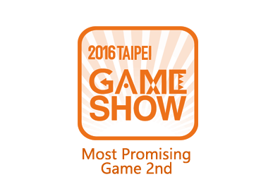







Case Study
ICEY
Genre | 2D Side-scrolling Action
Release Date | 17 Nov, 2016
Developer | FantaBlade Network
All Reviews | 91% positive (Steam)
 | 84/100 (Metacritic)
 | 8.6/10 (Gamersky)
Sales | Over 2 million
Points
This 2D action game developed in China has been a great success. And this kind of local 2D action game is very popular in the Chinese market.
This kind of 2D action game is not restricted by terminal and device. So this kind of game can attract a wider range of players.
Players are easily attracted to the traditional culture and stories in the game. This kind of game can better integrate story and traditional culture elements into game play and style.
Awards

Slide 7
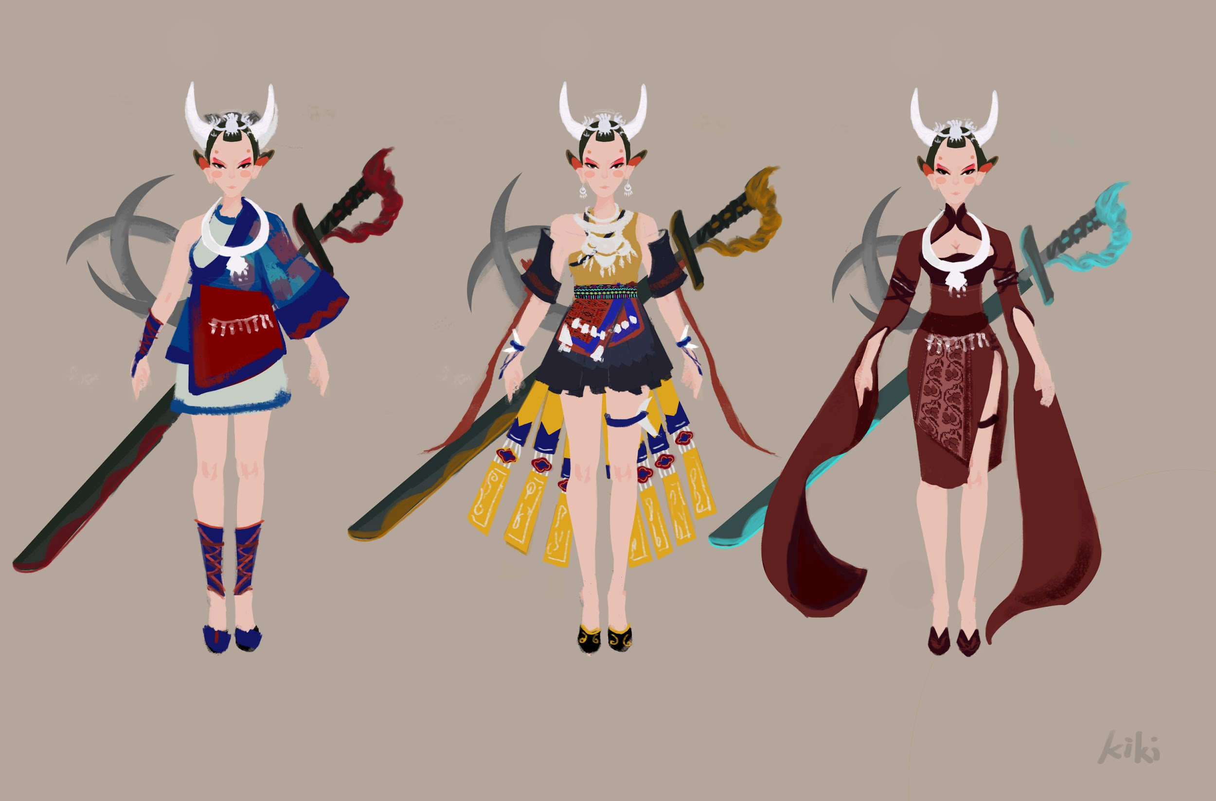
Character Design

Slide 8
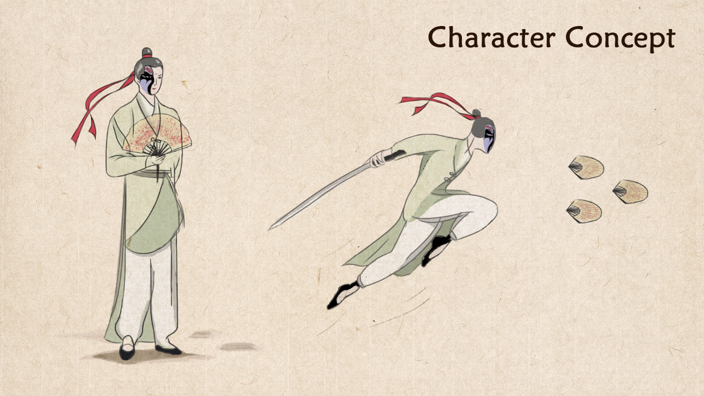

Slide 9
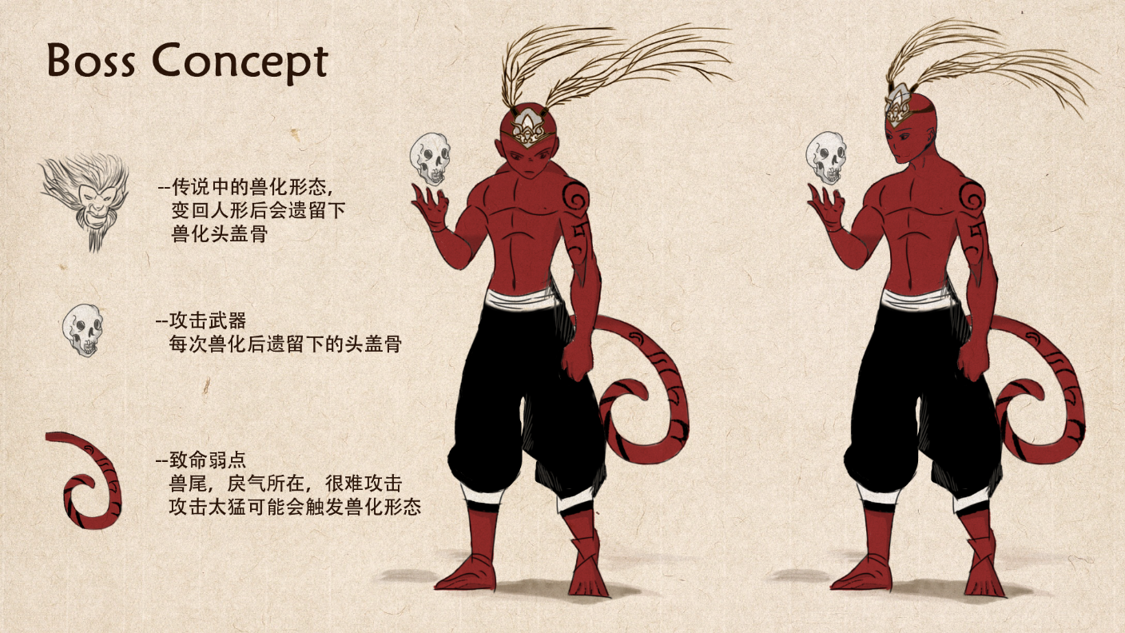

Slide 10

City Builder
Casual Game，Mobile

Slide 11
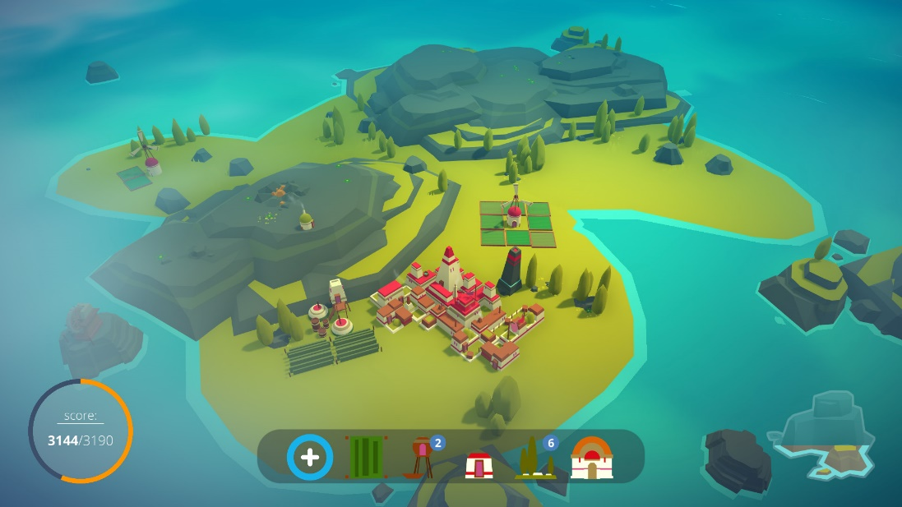
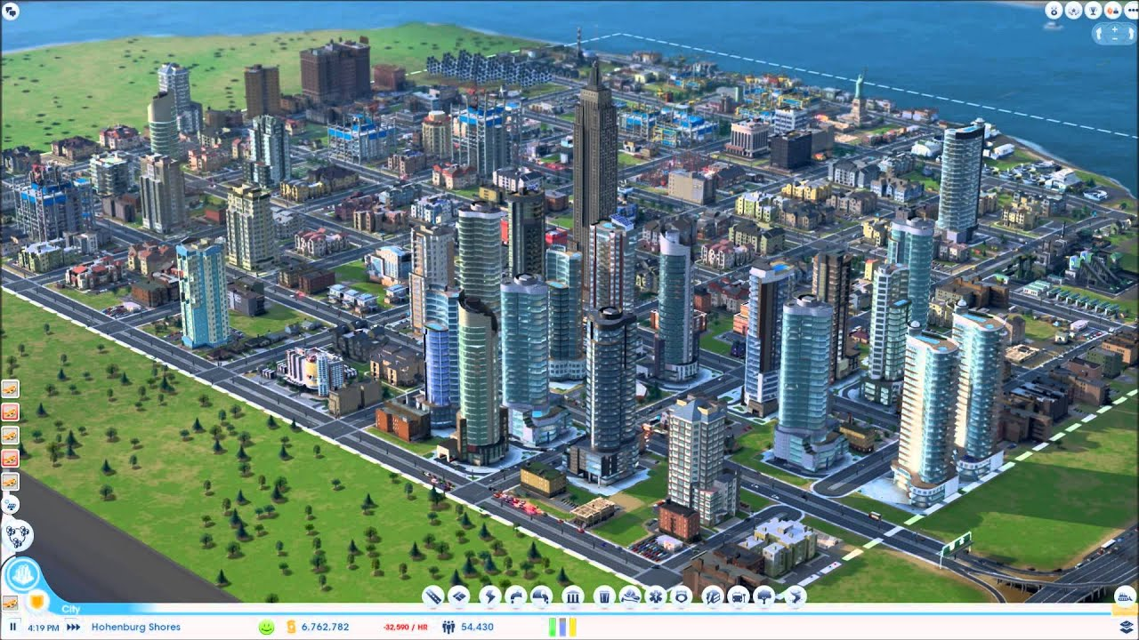
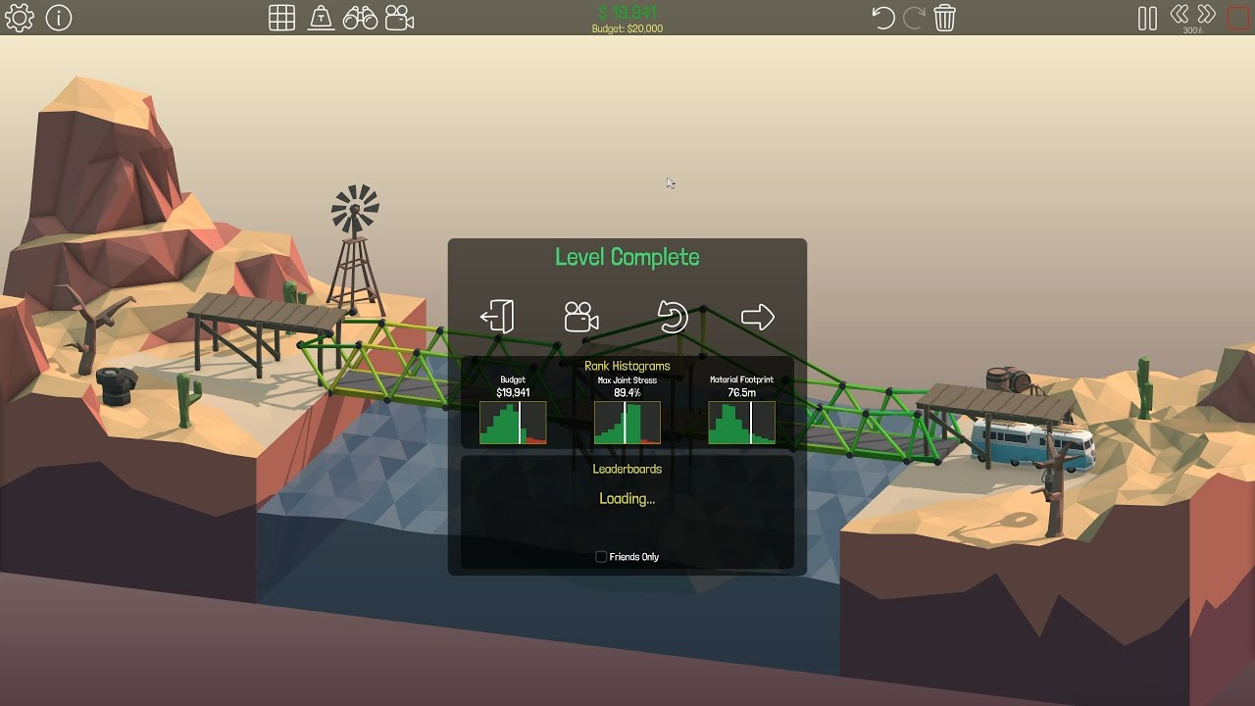
What is our game
A casual game with simulation and puzzle element
Sandbox play mode for further exploration and creation
Multi Score system for social media post
Low-poly/Isometric artstyle

Slide 12
Core Mechanism
Different buildings have different complex effect with other buildings
Randomly Generated building list (referenced AutoChess)
-2
+4
+3
Ranked building level and random possibility for gathering different buildings
-4
+1

Slide 13
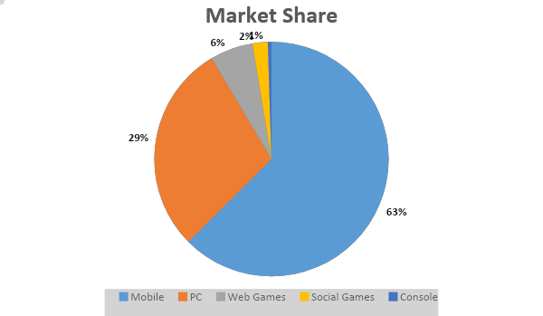
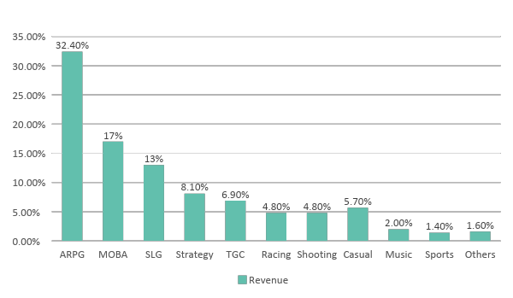
Data Analyse
Strategy/Simulation Game provide more than 10% revenue
Mobile game occupied 62.5% Chinese game market
Data Sauce: Perfect World

Slide 14
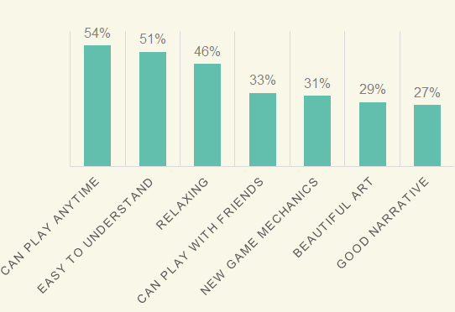
Why people play casual game
For Players
Easy to learn
Flexible play time
Competitive when social media involved
All age/gender friendly
For Publisher/Market
Low cost, high profit
Easy for localization
Will not have problem with censorship
Data Sauce: Perfect World

Slide 15
Thank You!

